Slide 1



Doctoral Studies Center in Information and Engineering Sciences and Technologies (ST2I)
Explainable Artificial Intelligence (XAI) for Decision-Making
in Graph-Based Recommendation Systems
PhD Viva Presented by: Redwane NESMAOUI
Jury members:
President | Pr. Abdellatif EL AFIA | PES | ENSIAS, Mohammed V University, Rabat
Supervisor | Pr. Mohamed LAZAAR | PES | ENSIAS, Mohammed V University, Rabat
Reviewer | Pr. M’hamed AIT KBIR | PES | FST, Abdelmalek Essaâdi University, Tangier
Reviewer | Pr. Oussama MAHBOUB | PES | ENSA, Abdelmalek Essaâdi University, Tetouan
Reviewer | Pr. Noureddine KERZAZI | MCH | ENSIAS, Mohammed V University, Rabat
Examiner | Pr. Hicham OMARA | MCH | FP Taza, Sidi Mohamed Ben Abdellah University, Fez
Examiner | Pr. Fatima OUZAYD | PES | ENSIAS, Mohammed V University, Rabat
Examiner | Pr. Yasser EL MADANI EL ALAMI | MCH | ENSIAS, Mohammed V University, Rabat
Guest | Pr. Yassine AFOUDI | MC | Faculty of Sciences, Cadi Ayyad University, Marrakech
Notes:
Good morning. Thank you, President, Professors, for being here today and having time to judge and discuss my thesis. My name is Redwane Nesmaoui, and I'll be presenting my PhD thesis: *Explainable Artificial Intelligence for Decision-Making in Graph-Based Recommendation Systems*, supervised by Professor Mohamed Lazaar.

Slide 2







VIVA Outline
Introduction
Recommenders
Black-box problem
Why XAI
Context & Problematic
Limitations
Research gap
Protocols
Datasets
Baseline
Metrics
Hardware
Contributions
GNN-CF
Adaptive Shapley
Hyperbolic GNN+XAI
Conclusion & Perspectives
Summary
Limitations
Future work
PhD Viva – Redwane NESMAOUI – XAI for Decision-Making in Graph-Based Recommendation Systems
Notes:
I'll walk you through five parts: the context and motivation, the experimental setup shared across contributions, my three research contributions, and finally the conclusion and perspectives. Each contribution follows the same structure objectives, methodology, results, and findings so you'll always know where we are.

Slide 3
Introduction
PhD Viva – Redwane NESMAOUI – XAI for Decision-Making in Graph-Based Recommendation Systems
Notes:
Let's start with the introduction.

Slide 4






Introduction
General Context
Examples of AI Powered Recommendation Systems
Ubiquity
How do recommender systems shape what billions of users see, buy, and watch every day?
The Black Box
Why do state-of-the-art graph based RS remain opaque to the users and designers who rely on them?
Toward Trust
How can transparency be built as part of the recommendation process instead of afterwards?
Motivating references
[1] Y. Zhang and X. Chen, "Explainable Recommendation: A Survey and New Perspectives," Foundations and Trends in Information Retrieval, vol. 14, no. 1, pp. 1–101, 2020.
[2] D. Gunning and D. W. Aha, "DARPA's Explainable Artificial Intelligence (XAI) Program," AI Magazine, vol. 40, no. 2, pp. 44–58, 2019.
[3] A. Das and P. Rad, "Opportunities and Challenges in Explainable Artificial Intelligence (XAI): A Survey," arXiv:2006.11371, 2020.
[4] P. Linardatos, V. Papastefanopoulos, and S. Kotsiantis, "Explainable AI: A Review of Machine Learning Interpretability Methods," Entropy, vol. 23, no. 1, p. 18, 2021.
[5] J. Kunkel, T. Donkers, L. Michael, C.-M. Barbu, and J. Ziegler, "Let Me Explain: Impact of Personal and Impersonal Explanations on Trust in Recommender Systems," in Proc. CHI Conf. Human Factors in Computing Systems (CHI), 2019, pp. 1–12.
[6] A. Jacovi, A. Marasović, T. Miller, and Y. Goldberg, "Formalizing Trust in Artificial Intelligence: Prerequisites, Causes and Goals of Human Trust in AI," in Proc. ACM Conf. Fairness, Accountability, and Transparency (FAccT), 2021, pp. 624–635.
PhD Viva – Redwane NESMAOUI – XAI for Decision-Making in Graph-Based Recommendation Systems
Notes:
Recommender systems shape what billions of users see, buy, and watch every day from Netflix to Amazon. But state-of-the-art graph-based recommenders remain opaque: they're accurate, but neither users nor designers can easily understand *why* a given item was recommended. This raises the central question of trust: how do we build transparency into the recommendation process itself, rather than bolting on an explanation afterward? That tension between predictive power and interpretability is the starting point of this thesis.

Slide 5
Introduction
General Context
Examples of AI Powered Recommendation systems
Netflix – Movie and TV recommendation platform.
Spotify – Music recommendation and streaming service.
Yelp – Local business and restaurant recommendation platform.
Amazon – E-commerce platform with personalized product recommendations.
[7] S. Raza, M. Rahman, S. Kamawal, A. Toroghi, A. Raval, F. Navah, and A. Kazemeini, “A Comprehensive Review of Recommender Systems: Transitioning from Theory to Practice,” Computer Science Review, 2026.
[8] O. A. S. Ibrahim, E. M. G. Younis, E. A. Mohamed, and W. N. Ismail, “Revisiting Recommender Systems: An Investigative Survey,” Neural Computing and Applications, 2025.
[9] L. Harichandan, S. Nayak, and R. K. Lenka, “A Comprehensive Review on Video Recommendation Systems: Models, Challenges, and Applications,” Journal of Engineering Science and Technology Review, 2025.
[10] S. Raza, M. Rahman, S. Kamawal, A. Toroghi, A. Raval, F. Navah, and A. Kazemeini, “A Comprehensive Review of Recommender Systems: Transitioning from Theory to Practice,” arXiv preprint arXiv:2407.13699, 2024.
PhD Viva – Redwane NESMAOUI – XAI for Decision-Making in Graph-Based Recommendation Systems
Notes:
These are not abstract concerns Netflix, Spotify, Yelp, Amazon all rely on recommendation engines as a core part of their product. Netflix's estimate that recommendations save it over a billion dollars a year in retention.) The scale of deployment is exactly why explainability matters, small biases or errors are amplified across millions of users.

Slide 6
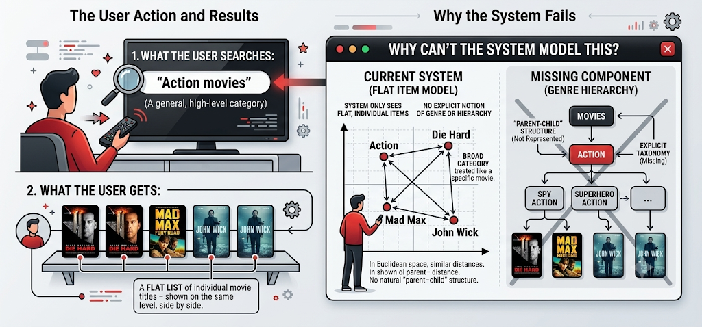

Introduction
General Context
Examples of AI Powered Recommendation systems
PhD Viva – Redwane NESMAOUI – XAI for Decision-Making in Graph-Based Recommendation Systems
Notes:
These are not abstract concerns Netflix, Spotify, Yelp, Amazon all rely on recommendation engines as a core part of their product. Netflix's estimate that recommendations save it over a billion dollars a year in retention.) The scale of deployment is exactly why explainability matters, small biases or errors are amplified across millions of users.

Slide 7
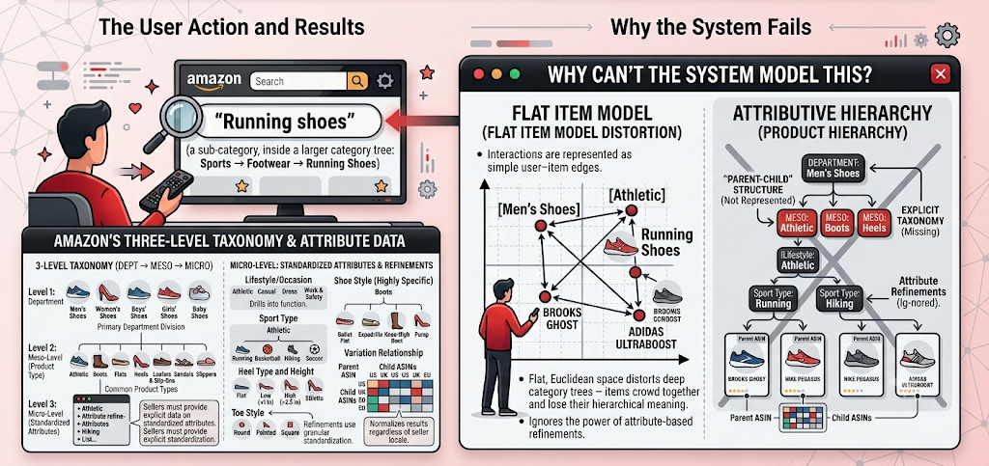

Introduction
General Context
Examples of AI Powered Recommendation systems
PhD Viva – Redwane NESMAOUI – XAI for Decision-Making in Graph-Based Recommendation Systems
Notes:
These are not abstract concerns Netflix, Spotify, Yelp, Amazon all rely on recommendation engines as a core part of their product. Netflix's estimate that recommendations save it over a billion dollars a year in retention.) The scale of deployment is exactly why explainability matters, small biases or errors are amplified across millions of users.

Slide 8

Context and Problematic
PhD Viva – Redwane NESMAOUI – XAI for Decision-Making in Graph-Based Recommendation Systems
Notes:
Now let's look more precisely at the problem this thesis addresses.

Slide 9






Context and Problematic
Recommendation Systems
Problematic
Contributions
Recommendation Systems promotes products by leveraging the internet and electronic devices for efficient global reach.
It offers new ways to communicate, engage and convert audiences into customers.
Predictive Analytics
Automation
Data Insights
Enhanced Decision Making
PhD Viva – Redwane NESMAOUI – XAI for Decision-Making in Graph-Based Recommendation Systems
Notes:
Recommender systems drive engagement through predictive analytics, automation, data insights, and enhanced decision-making. They're a key lever for converting audience attention into business value but that lever needs to be trustworthy.

Slide 10
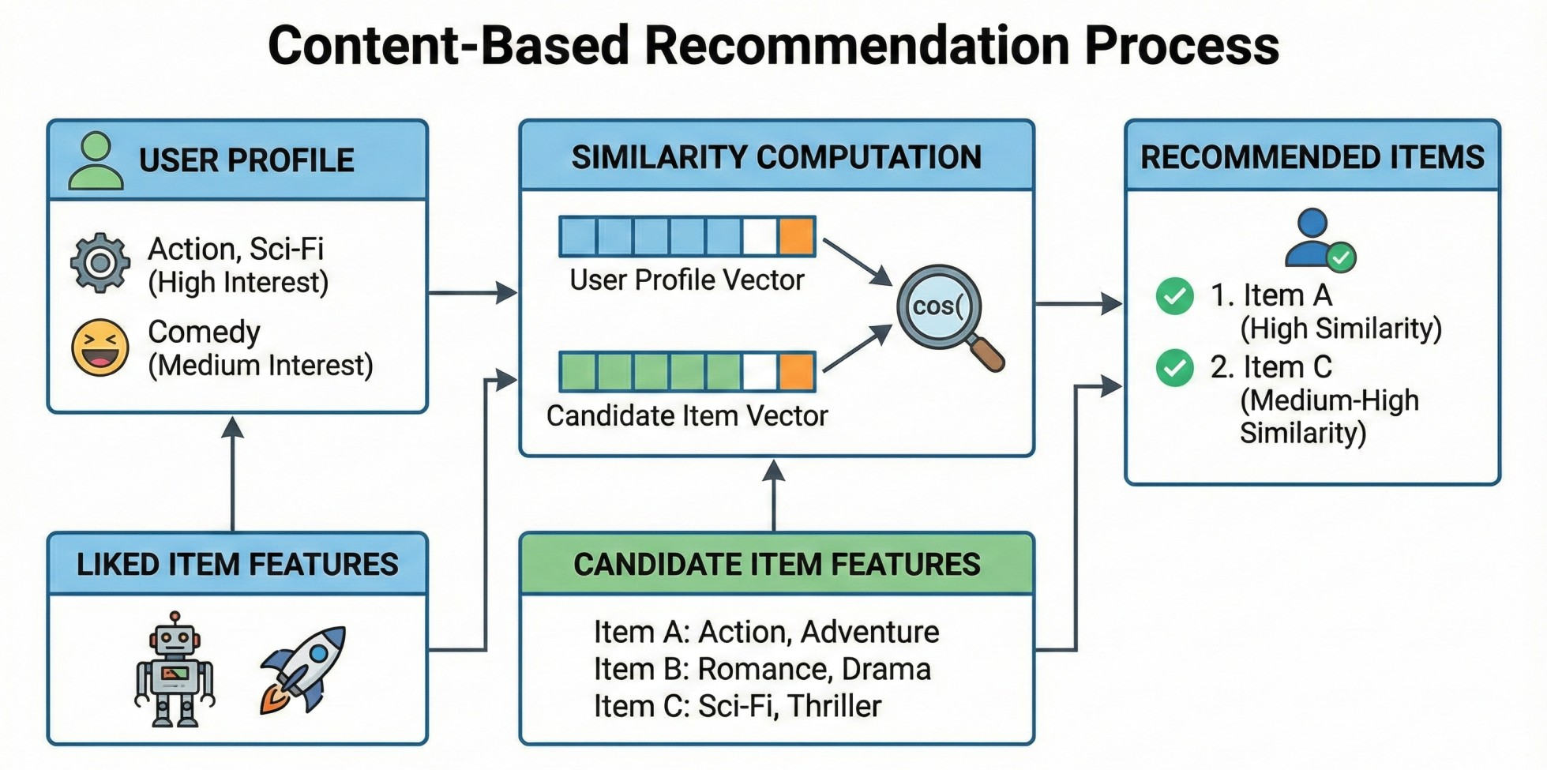
Context and Problematic
Recommendation Systems
Problematic
Contributions
Content-Based Filtering
Recommends items based on their features and the user’s past preferences.
Builds a user profile from previously liked, viewed, or selected items.
Suggests new items with similar characteristics.
Limitation: recommendations may become too similar and lack diversity.
[11] M. J. Pazzani and D. Billsus, "Content-Based Recommendation Systems," in The Adaptive Web, P. Brusilovsky, A. Kobsa, and W. Nejdl, Eds. Berlin, Germany: Springer, 2007, pp. 325–341.
PhD Viva – Redwane NESMAOUI – XAI for Decision-Making in Graph-Based Recommendation Systems
Notes:
Recommender systems drive engagement through predictive analytics, automation, data insights, and enhanced decision-making. They're a key lever for converting audience attention into business value but that lever needs to be trustworthy.

Slide 11
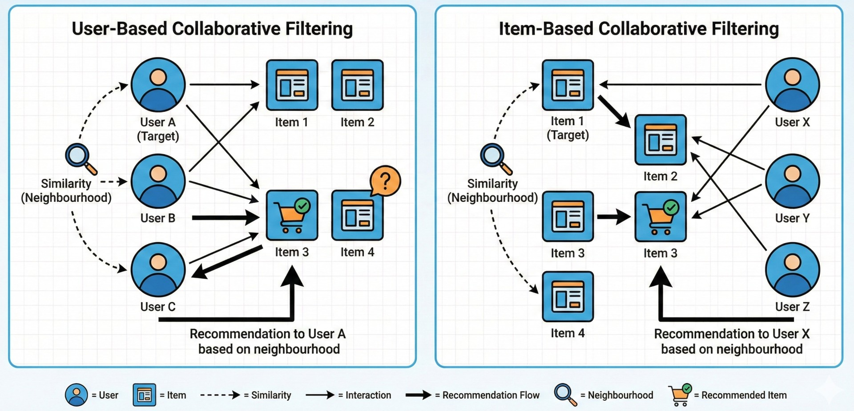
Context and Problematic
Recommendation Systems
Problematic
Contributions
Collaborative Filtering
Recommends items using preferences and behaviors of similar users.
Identifies patterns in user–item interactions, such as ratings, clicks, or purchases.
Can be user-based or item-based collaborative filtering.
Limitation: it struggles with new users or new items due to limited data.
[12] J. L. Herlocker, J. A. Konstan, A. Borchers, and J. Riedl, "An Algorithmic Framework for Performing Collaborative Filtering," in Proc. 22nd Annual International ACM SIGIR Conference on Research and Development in Information Retrieval, Berkeley, CA, USA, 1999, pp. 230–237.
PhD Viva – Redwane NESMAOUI – XAI for Decision-Making in Graph-Based Recommendation Systems
Notes:
Recommender systems drive engagement through predictive analytics, automation, data insights, and enhanced decision-making. They're a key lever for converting audience attention into business value but that lever needs to be trustworthy.

Slide 12
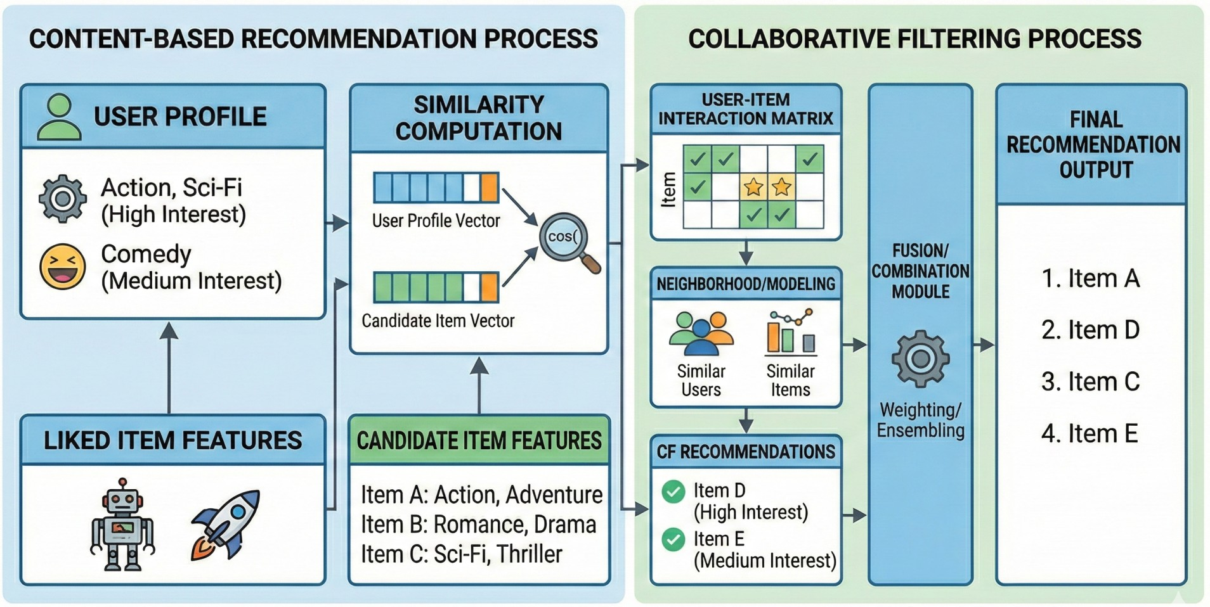
Context and Problematic
Recommendation Systems
Problematic
Contributions
Hybrid Recommendation Approach
Combines content-based and collaborative filtering methods.
Uses both item features and user–item interaction data.
Improves recommendation accuracy and reduces the weaknesses of individual methods.
Can better handle issues such as limited data, overspecialization, and the cold-start problem.
[13] R. Burke, "Hybrid Recommender Systems: Survey and Experiments," User Modeling and User-Adapted Interaction, vol. 12, no. 4, pp. 331–370, 2002.
PhD Viva – Redwane NESMAOUI – XAI for Decision-Making in Graph-Based Recommendation Systems
Notes:
Recommender systems drive engagement through predictive analytics, automation, data insights, and enhanced decision-making. They're a key lever for converting audience attention into business value but that lever needs to be trustworthy.

Slide 13
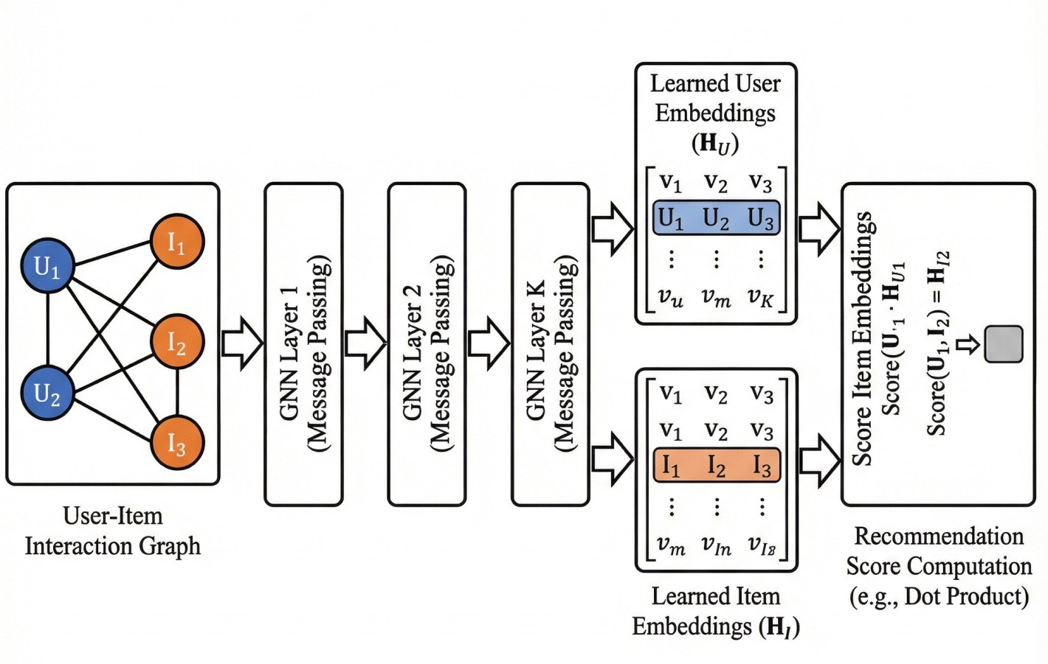
Context and Problematic
Recommendation Systems
Problematic
Contributions
Graph-Based Recommendation Systems
Represents users, items, and their interactions as nodes and edges in a graph.
Uses graph structure to discover relationships and multi-hop connections.
Applies methods such as random walks, graph embeddings, or graph neural networks.
Limitation: large graphs can require significant computation and memory.
[14] X. Wu, X. He, A. K. Chua, and T.-S. Chua, "A Survey on Graph Neural Networks for Recommender Systems,“ ACM Computing Surveys, vol. 57, no. 2, pp. 1–37, 2025.
PhD Viva – Redwane NESMAOUI – XAI for Decision-Making in Graph-Based Recommendation Systems
Notes:
Recommender systems drive engagement through predictive analytics, automation, data insights, and enhanced decision-making. They're a key lever for converting audience attention into business value but that lever needs to be trustworthy.

Slide 14
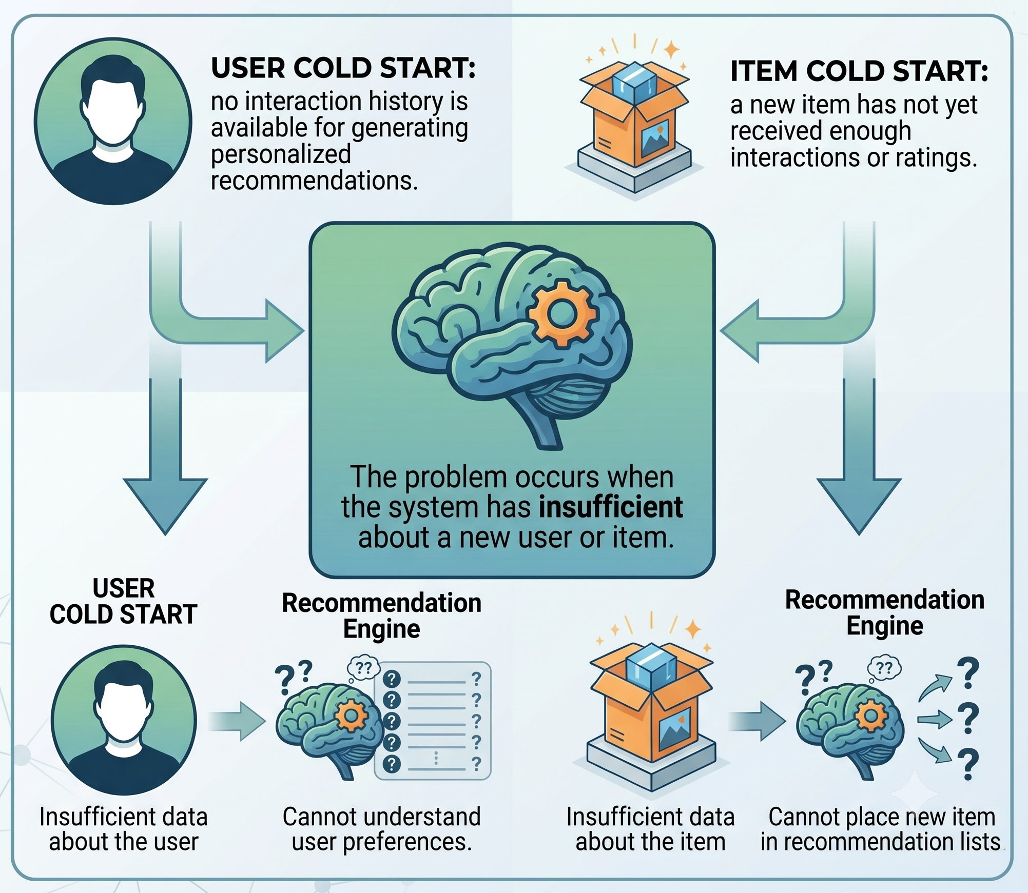
Context and Problematic
Recommendation Systems
Problematic
Contributions
Cold-Start Problem
Occurs when the system has insufficient data about a new user or item.
User cold start: no interaction history is available for generating personalized recommendations.
Item cold start: a new item has not yet received enough interactions or ratings.
Common solutions include onboarding questions, demographic data, item features, and hybrid recommendation methods.
[15] M. Kolli, L. D. Mukil, N. Kartthikeyan, M. Pranavkrishnan, N. Sampath, and P. C. Nair, "Addressing the Cold Start Challenge through the Implementation of Content-Based Filtering and Hybrid Filtering for Movie Recommendation," in Proc. 15th International Conference on Computing Communication and Networking Technologies (ICCCNT), IEEE, 2024.
PhD Viva – Redwane NESMAOUI – XAI for Decision-Making in Graph-Based Recommendation Systems
Notes:
Recommender systems drive engagement through predictive analytics, automation, data insights, and enhanced decision-making. They're a key lever for converting audience attention into business value but that lever needs to be trustworthy.

Slide 15
Context and Problematic
Recommendation Systems
Problematic & Objectives
Contributions
Graph-based recommender systems deliver strong performance, but they often remain black boxes that are difficult to explain.
Existing explainability methods are often post hoc and weakly integrated into the recommendation process [11].
Design a unified framework combining accuracy, explainability, adaptability, and hierarchical modeling.
User preferences evolve over time, but most models struggle to adapt to these changes [12].
Hierarchical structures, categories, subcategories, and taxonomies are poorly represented in conventional Euclidean spaces.
[11] A. Kamal, A. Ragno, M. Plantevit, et al., "Leveraging Internal Representations of GNNs With Shapley Values," Data Min. Knowl. Discov., vol. 39, no. 89, 2025.
[12] L. Wu, D. Hao, and Z. Fan, "Explainable Graph Neural Networks via Structural Externalities," in Proc. 34th Int. Joint Conf. Artif. Intell. (IJCAI), 2025, pp. 583–591.
PhD Viva – Redwane NESMAOUI – XAI for Decision-Making in Graph-Based Recommendation Systems
Notes:
Three structural problems motivate this work. First, graph-based recommenders perform well but remain black boxes. Second, existing explainability methods are largely post-hoc and weakly integrated they explain a decision after it's made, rather than shaping it. Third, hierarchical structures categories, subcategories, taxonomies are poorly represented in the Euclidean spaces most models use. My objective is to design a unified framework that brings together accuracy, explainability, adaptability, and hierarchical modeling.

Slide 16
Context and Problematic
Recommendation Systems
Problematic & Objectives
Contributions
Graph-based collaborative filtering with a LightGCN style recommender
Shapley-value-based explanation of historical user-item interactions
Adaptive recommendation through contributio-aware inference-time reweighting
Hierarchical recommendation using hyperbolic graph neural networks
Unified experimental validation on MovieLens and Amazon, combining accuracy and interpretability analysis
PhD Viva – Redwane NESMAOUI – XAI for Decision-Making in Graph-Based Recommendation Systems
Notes:
This objective translates into three concrete contributions, which I'll present in order: first, a graph-based collaborative filtering baseline; second, a Shapley-value-based adaptive reweighting mechanism; and third, a hyperbolic graph neural network that combines hierarchy-awareness with explainability. All three are validated on MovieLens and Amazon.

Slide 17
Protocols
PhD Viva – Redwane NESMAOUI – XAI for Decision-Making in Graph-Based Recommendation Systems
Notes:
Before the contributions, let me briefly cover the shared experimental setup.

Slide 18
Experiment Setup
Datasets
Metrics
Hardware
MovieLens 100k
100,000 ratings from about 1,000 users on 1,700 movies, collected between 1997 and 1998.
One of the earliest standard recommender benchmarks, still used today for fast prototyping and ablation studies
its smaller size allows for running ablations and sensitivity tests quickly, alongside the larger MovieLens 1M.
Specification | MovieLens 100K
Number of users | 943
Number of items | 1,682 movies
Number of interactions | 100,000 ratings
Rating scale | 1–5 stars
Minimum interactions per user | 20 ratings
Approximate sparsity | 93.7%
[16] F. Maxwell Harper and J. A. Konstan, "MovieLens 100K Dataset," GroupLens Research, University of Minnesota. Available: https://grouplens.org/datasets/movielens/100k/
[17] F. M. Harper and J. A. Konstan, "The MovieLens Datasets: History and Context," ACM Transactions on Interactive Intelligent Systems, vol. 5, no. 4, pp. 1–19, Dec. 2015, doi: 10.1145/2827872
[18] J. Bobadilla, F. Ortega, A. Hernando, and A. Gutiérrez, "Recommender Systems Survey," Knowledge-Based Systems, vol. 46, pp. 109–132, Jul. 2013
PhD Viva – Redwane NESMAOUI – XAI for Decision-Making in Graph-Based Recommendation Systems
Notes:
I use three datasets: MovieLens 1M, MovieLens 100K, and Amazon Product Reviews covering both movie recommendation and e-commerce, which lets me test generalization across domains.

Slide 19
Experiment Setup
Datasets
Metrics
Hardware
MovieLens 100k
Recommendation Performance Provides user–movie rating data to train and evaluate recommendation algorithms.
Algorithm Benchmarking Serves as a standard benchmark for fair comparison of collaborative filtering, graph neural networks, and deep learning methods.
Explainable Recommendation Enables analysis of user–item interactions to generate and evaluate interpretable recommendations.
User ID | Movie ID | Movie Title | Rating | Timestamp
1 | 1 | Toy Story (1995) | 5 | 874965758
1 | 32 | Crumb (1994) | 3 | 876893171
2 | 257 | Men in Black (1997) | 4 | 888550871
5 | 474 | Dr. Strangelove (1964) | 5 | 875635845
10 | 50 | Star Wars (1977) | 4 | 877888877
PhD Viva – Redwane NESMAOUI – XAI for Decision-Making in Graph-Based Recommendation Systems
Notes:
I use three datasets: MovieLens 1M, MovieLens 100K, and Amazon Product Reviews covering both movie recommendation and e-commerce, which lets me test generalization across domains.

Slide 20
Experiment Setup
Datasets
Metrics
Hardware
MovieLens 1M
About 1 million ratings, from 6,000 users on 4,000 movies, collected by GroupLens Research in 2000.
The standard benchmark for collaborative filtering research for over two decades, including LightGCN, NGCF, and most GNN recommenders.
Using this benchmark keeps the results directly comparable with prior work in graph-based recommendation.
Specification | MovieLens 1M
Number of users | 6,040
Number of items | 3,952 movie
Number of interactions | 1,000,209 ratings
Rating scale | 1–5 stars
Minimum interactions per user | 20 ratings
Approximate sparsity | 95.8%
[19] GroupLens Research, "MovieLens 1M Dataset," University of Minnesota. Available: https://grouplens.org/datasets/movielens/1m/
[20] F. M. Harper and J. A. Konstan, "The MovieLens Datasets: History and Context," ACM Transactions on Interactive Intelligent Systems, vol. 5, no. 4, Art. no. 19, Dec. 2015, doi: 10.1145/2827872.
[21] J. Bobadilla, F. Ortega, A. Hernando, and A. Gutiérrez, "Recommender Systems Survey," Knowledge-Based Systems, vol. 46, pp. 109–132, Jul. 2013.
PhD Viva – Redwane NESMAOUI – XAI for Decision-Making in Graph-Based Recommendation Systems
Notes:
I use three datasets: MovieLens 1M, MovieLens 100K, and Amazon Product Reviews covering both movie recommendation and e-commerce, which lets me test generalization across domains.

Slide 21
Experiment Setup
Datasets
Metrics
Hardware
MovieLens 1M
Scalable Recommendation Evaluation: Provides over 1 million user–movie ratings, enabling the evaluation of recommendation algorithms on a larger and more realistic dataset than MovieLens 100K.
Benchmarking Advanced Models: Serves as a standard benchmark for comparing collaborative filtering, matrix factorization, graph neural networks, deep learning, and explainable recommendation methods.
Learning Rich User Preferences: Includes demographic information (age, gender, occupation), movie genres, timestamps, and ratings, allowing researchers to model user behavior and improve recommendation quality.
PhD Viva – Redwane NESMAOUI – XAI for Decision-Making in Graph-Based Recommendation Systems
Notes:
I use three datasets: MovieLens 1M, MovieLens 100K, and Amazon Product Reviews covering both movie recommendation and e-commerce, which lets me test generalization across domains.

Slide 22
Experiment Setup
Datasets
Metrics
Hardware
MovieLens 1M
User ID | Movie ID | Movie Title | Rating | Gender | Age | Occupation | Timestamp
1 | 1193 | One Flew Over the Cuckoo's Nest | 5 | F | 16 | 10 | 978300760
1 | 661 | James and the Giant Peach | 3 | F | 17 | 10 | 978302109
2 | 914 | My Fair Lady | 4 | M | 56 | 16 | 978298709
5 | 3408 | Erin Brockovich | 4 | M | 25 | 20 | 978245234
10 | 2571 | Matrix, The | 5 | F | 35 | 1 | 978228345
PhD Viva – Redwane NESMAOUI – XAI for Decision-Making in Graph-Based Recommendation Systems
Notes:
I use three datasets: MovieLens 1M, MovieLens 100K, and Amazon Product Reviews covering both movie recommendation and e-commerce, which lets me test generalization across domains.

Slide 23
Experiment Setup
Datasets
Metrics
Hardware
Amazon Products
Large-scale e-commerce ratings and reviews collected by the McAuley Lab, UC San Diego, through 2018.
Review-based and sentiment-aware recommendation, and evaluating models at realistic, large, sparse scale
It tests whether the proposed methods generalize beyond movies , to e-commerce data with very different scale and sparsity.
Specification | Amazon Products
Number of users | ≈15.5 million
Number of items | ≈9.4 million products
Number of interactions | ≈233.1 million reviews
Rating scale | 1–5 stars
Minimum interactions per user | No fixed minimum
Approximate sparsity | Extremely sparse
[22] J. McAuley Lab, “Amazon Review Data (2018),” University of California San Diego. [Online]. Available: https://cseweb.ucsd.edu/~jmcauley/datasets/amazon_v2/
PhD Viva – Redwane NESMAOUI – XAI for Decision-Making in Graph-Based Recommendation Systems
Notes:
I use three datasets: MovieLens 1M, MovieLens 100K, and Amazon Product Reviews covering both movie recommendation and e-commerce, which lets me test generalization across domains.

Slide 24
Experiment Setup
Datasets
Metrics
Hardware
Amazon Products
Large-Scale Recommendation: Provides millions of user–product interactions for training and evaluating recommendation algorithms on real-world e-commerce data.
Personalized Product Recommendation: Includes user ratings, product metadata, categories, brands, and review history to model user preferences and improve recommendation quality.
Explainable and Context-Aware Recommendation: Contains review text, helpfulness votes, and product attributes, enabling explainable recommendations and sentiment-aware recommendation models.
PhD Viva – Redwane NESMAOUI – XAI for Decision-Making in Graph-Based Recommendation Systems
Notes:
I use three datasets: MovieLens 1M, MovieLens 100K, and Amazon Product Reviews covering both movie recommendation and e-commerce, which lets me test generalization across domains.

Slide 25
Experiment Setup
Datasets
Metrics
Hardware
Amazon Products
User ID | Product ID (ASIN) | Category | Rating | Review Summary | Brand
A1B2C3 | B000123XYZ | Electronics | 5 | Excellent sound quality | Sony
A4D5E6 | B000456ABC | Books | 4 | Informative and well written | Penguin
A7F8G9 | B000789DEF | Home & Kitchen | 3 | Average quality | KitchenAid
A2H3I4 | B000321GHI | Clothing | 5 | Fits perfectly | Levi's
A5J6K7 | B000654JKL | Sports | 4 | Good value for money | Nike
PhD Viva – Redwane NESMAOUI – XAI for Decision-Making in Graph-Based Recommendation Systems
Notes:
I use three datasets: MovieLens 1M, MovieLens 100K, and Amazon Product Reviews covering both movie recommendation and e-commerce, which lets me test generalization across domains.

Slide 26
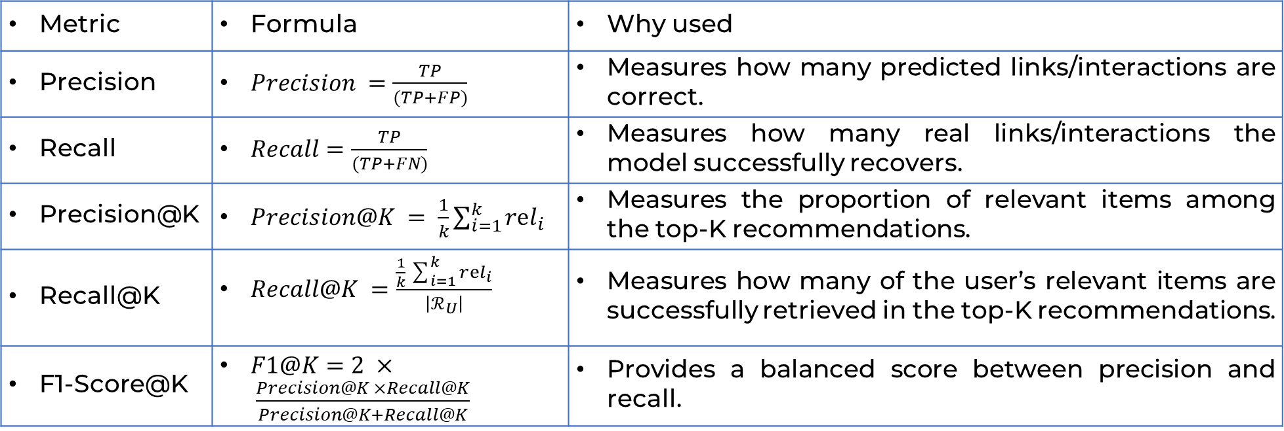
Experiment Setup
Datasets
Metrics
Hardware
Metric | Formula | Why used
Precision | $Precision =\frac{TP}{(TP+FP)}$ | Measures how many predicted links/interactions are correct.
Recall | $Recall=\frac{TP}{(TP+FN)}$ | Measures how many real links/interactions the model successfully recovers.
Precision@K | $Precision@K = \frac{1}{k}\sum_{i=1}^{k}{rel_{i}}$ | Measures the proportion of relevant items among the top-K recommendations.
Recall@K | $Recall@K =\frac{\frac{1}{k}\sum_{i=1}^{k}{rⅇl_{i}}}{\left|ℛ_{U}\right|}$ | Measures how many of the user’s relevant items are successfully retrieved in the top-K recommendations.
F1-Score@K | $F1@K=2 × \frac{Precision@K ×Recall@K}{Precision@K+Recall@K}$ | Provides a balanced score between precision and recall.
Notations
$TP$ = true positives, $FP$ = false positives, $FN$ = false negatives, $rel_{i}$ = relevance of item at rank $i$ , and $ℛ_{U}$ = total number of relevant items for user u.
PhD Viva – Redwane NESMAOUI – XAI for Decision-Making in Graph-Based Recommendation Systems
Notes:
I evaluate primarily with Precision, Recall, and F1, for top-K recommendation I won't read the formulas, but happy to detail them in questions if needed.

Slide 27
Experiment Setup
Datasets
Metrics
Hardware
Contribution | Hardware | CPU / Chip | RAM | Storage
First | Lenovo ThinkPad X1 Carbon | Intel Core i7-7600U | 16 GB | 512 GB
Second and Third | MacBook Pro | Apple M4 Max | 48 GB | 1 TB
PhD Viva – Redwane NESMAOUI – XAI for Decision-Making in Graph-Based Recommendation Systems
Notes:
Experiments ran on a ThinkPad X1 Carbon for the first contribution and a MacBook Pro M4 Max for the second and third, I mention this mainly for reproducibility and because it explains some of the runtime figures you'll see later

Slide 28
Contribution I
Collaborative Filtering Movies Recommendation System based on Graph Neural Networks
PhD Viva – Redwane NESMAOUI – XAI for Decision-Making in Graph-Based Recommendation Systems
Notes:
Let's move to the first contribution: a collaborative filtering movie recommender based on graph neural networks.

Slide 29
Collaborative Filtering Movies Recommendation System based on Graph Neural Networks
Objectives
Methodology
Results
Findings
Research Gap
Sparse interaction matrices provide limited learning signals.
Classical collaborative filtering poorly captures indirect, multi-hop user–item relationships.
Matrix-based models ignore the natural graph structure of recommendation data.
Research Gap
There is a need for a graph-based collaborative filtering model that directly exploits higher-order user–item connectivity, without relying on side information, to improve recommendation performance in sparse settings.
[23] Y. Zhang and X. Chen, "Explainable Recommendation: A Survey and New Perspectives,“ IEEE Access, vol. 8, pp. 110-120, 2020.
[24] B. P. Chamberlain, S. R. Hardwick, D. R. Wardrope, F. Dzogang, F. Daolio, and S. Vargas, "Scalable Hyperbolic Recommender Systems," arXiv:1902.08648, 2019.
PhD Viva – Redwane NESMAOUI – XAI for Decision-Making in Graph-Based Recommendation Systems
Notes:
Classical collaborative filtering has a real limitation: it operates on sparse interaction matrices and can't capture indirect, multi-hop relationships between users and items, it ignores the natural graph structure of the data. The gap is a graph-based model that exploits higher-order connectivity directly, without extra side information, to improve performance in sparse settings.

Slide 30
Collaborative Filtering Movies Recommendation System based on Graph Neural Networks
Objectives
Methodology
Results
Findings
Research Questions → Objectives
ID | Research Question | Objective
RQ1.1 | Does graph-based link prediction outperform traditional collaborative filtering methods? | Compare LightGCN with UBCF, IBCF, MF, SVD, and SVD++.
RQ1.2 | Do multi-hop propagation and layer aggregation improve collaborative learning? | Combine user–item representations across multiple graph layers.
RQ1.3 | Can a simple graph model support stable future extensions? | Use linear aggregation and inner-product scoring.
RQ1.4 | What limitations remain despite improved accuracy? | Identify static, uniform, and opaque interactions to motivate Contribution 2.
PhD Viva – Redwane NESMAOUI – XAI for Decision-Making in Graph-Based Recommendation Systems
Notes:
I structure this contribution around four questions: does graph-based link prediction beat traditional CF methods; does multi-hop propagation help; can a simple graph model support future extensions; and what limitations remain. That last question is deliberately there, it's what motivates Contribution II.

Slide 31
Collaborative Filtering Movies Recommendation System based on Graph Neural Networks
Objectives
Methodology
Results
Findings
Euclidean Space
Flat, normal geometry distance is a straight line between two points, the space we use every day.
The standard choice for embeddings: matrix factorisation, word embeddings, and most graph neural networks, including LightGCN.
It is the natural starting point and the space used in Contribution I, before hierarchy motivates a different geometry later.
[25] Y. Koren, R. Bell, and C. Volinsky, "Matrix Factorization Techniques for Recommender Systems," IEEE Computer, vol. 42, no. 8, pp. 30–37, 2009.
PhD Viva – Redwane NESMAOUI – XAI for Decision-Making in Graph-Based Recommendation Systems
Notes:
The pipeline starts from user-item interactions, builds a bipartite graph, and initializes embeddings for users and items.

Slide 32
Collaborative Filtering Movies Recommendation System based on Graph Neural Networks
Objectives
Methodology
Results
Findings
Euclidean Space
PhD Viva – Redwane NESMAOUI – XAI for Decision-Making in Graph-Based Recommendation Systems
Notes:
Experiments ran on a ThinkPad X1 Carbon for the first contribution and a MacBook Pro M4 Max for the second and third, I mention this mainly for reproducibility and because it explains some of the runtime figures you'll see later

Slide 33
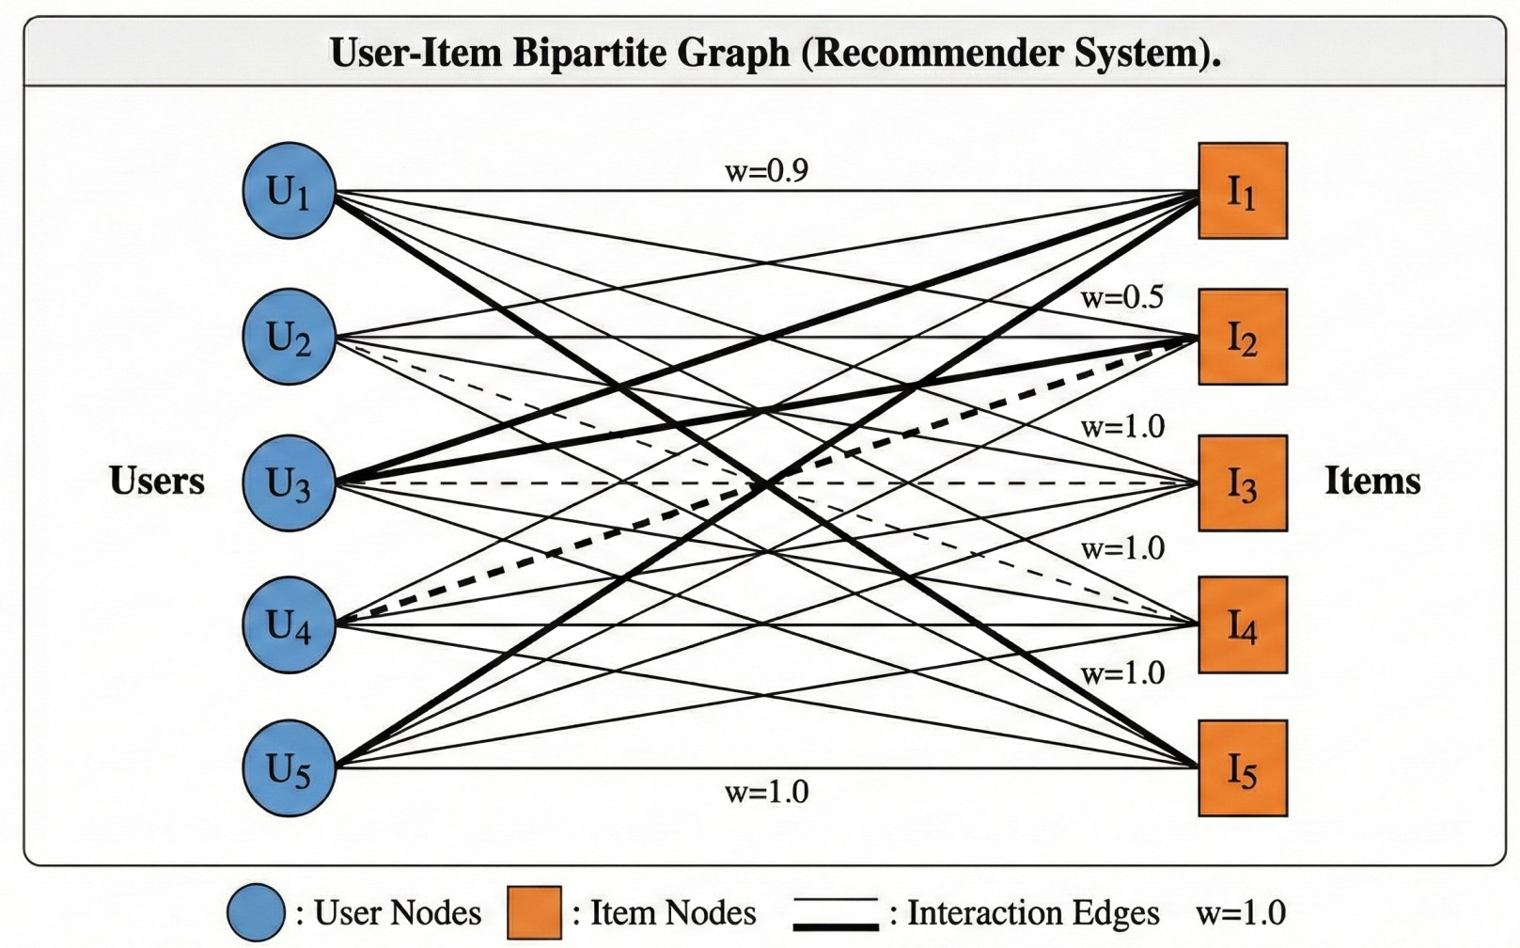
Collaborative Filtering Movies Recommendation System based on Graph Neural Networks
Objectives
Methodology
Results
Findings
Architecture Walkthrough
Step1
User–Item Interaction Input
Bipartite Graph Construction
Embedding Initialization
PhD Viva – Redwane NESMAOUI – XAI for Decision-Making in Graph-Based Recommendation Systems
Notes:
The pipeline starts from user-item interactions, builds a bipartite graph, and initializes embeddings for users and items.

Slide 34
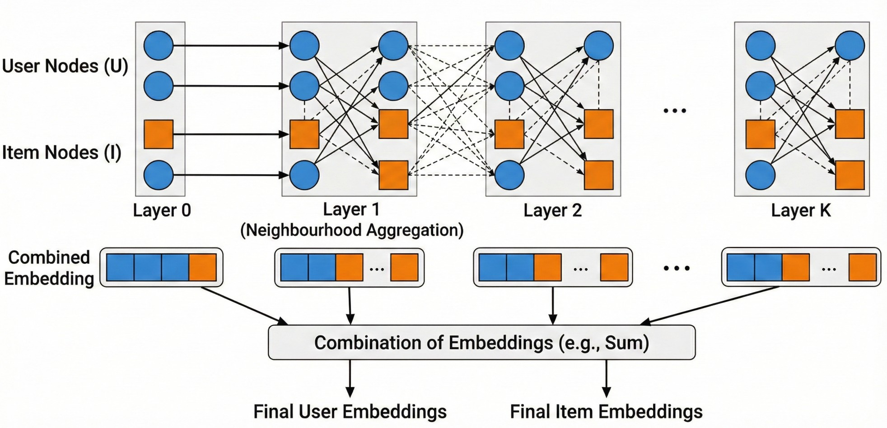
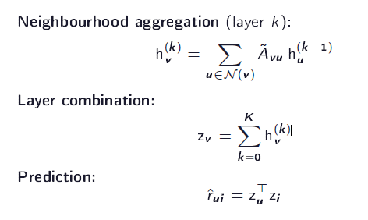
Collaborative Filtering Movies Recommendation System based on Graph Neural Networks
Objectives
Methodology
Results
Findings
Architecture Walkthrough
Step 2
PhD Viva – Redwane NESMAOUI – XAI for Decision-Making in Graph-Based Recommendation Systems
Notes:
Then we do neighborhood aggregation across multiple layers, combine the layers, and predict interactions via inner product — this is the LightGCN-style design.

Slide 35
Collaborative Filtering Movies Recommendation System based on Graph Neural Networks
Objectives
Methodology
Results
Findings
Key results findings
Best of all baselines
Biggest gain in recall
Captures multi-hop patterns invisible to matrix methods
Limitation: link-prediction, not Top-N
Method | Precision | Recall
UCBF | 0.7423 | 0.8015
IBCF | 0.7689 | 0.8247
MF | 0.8012 | 0.8619
SVD | 0.8294 | 0.8896
SVD++ | 0.8627 | 0.9138
LightGCN-CF | 0.9101 | 0.9625
PhD Viva – Redwane NESMAOUI – XAI for Decision-Making in Graph-Based Recommendation Systems
Notes:
LightGCN-CF beats every baseline, UBCF, IBCF, MF, SVD, SVD++ with the biggest gain in recall, confirming it captures multi-hop patterns invisible to matrix-based methods. The important caveat: this is a link-prediction evaluation, not full top-N ranking.

Slide 36
Collaborative Filtering Movies Recommendation System based on Graph Neural Networks
Objectives
Methodology
Results
Findings
Answers to the questions and objectives
Higher recall indicates that multi-hop propagation captures relevant interactions missed by similarity- and latent-factor methods.
The progression from UBCF to GNN-CF suggests that richer relational modelling improves link prediction.
However, the results do not yet establish explainability, temporal adaptation, or full-catalog top-N performance.
PhD Viva – Redwane NESMAOUI – XAI for Decision-Making in Graph-Based Recommendation Systems
Notes:
So: higher recall confirms multi-hop propagation adds value; the progression from UBCF to GNN-CF shows richer relational modeling helps link prediction. But, and this is important, these results don't yet establish explainability, temporal adaptation, or full-catalog top-N performance.

Slide 37
Collaborative Filtering Movies Recommendation System based on Graph Neural Networks
Objectives
Methodology
Results
Findings
Key findings
Graph structure improves prediction: Interaction connectivity adds value beyond matrix-based modelling.
Higher-order neighborhoods improve recall: Indirect signals recover interactions missed by direct similarity.
Simple architectures are sufficient: Complex nonlinear GNN components are unnecessary for a strong baseline.
Accuracy is not enough: The model remains static and opaque.
Evaluation scope must remain clear: the contribution addresses link prediction, not top-N ranking.
PhD Viva – Redwane NESMAOUI – XAI for Decision-Making in Graph-Based Recommendation Systems
Notes:
To summarize: graph structure improves prediction, higher-order neighborhoods improve recall, and simple architectures are sufficient as a strong baseline. But accuracy alone is not enough, the model remains static and opaque.

Slide 38
Collaborative Filtering Movies Recommendation System based on Graph Neural Networks
Objectives
Methodology
Results
Findings
Limitations
The model closely follows LightGCN and is not a fundamentally new GNN architecture.
Evaluation is limited to MovieLens-100k under a link-prediction protocol.
No ablation isolates propagation depth or layer aggregation.
Interactions are uniformly weighted, static, and not explicitly explainable.
The contribution describes the experiment as link prediction, not top-N recommendation.
PhD Viva – Redwane NESMAOUI – XAI for Decision-Making in Graph-Based Recommendation Systems
Notes:
This contribution closely follows LightGCN rather than proposing a fundamentally new architecture, evaluation is limited to MovieLens-1M under link prediction, and there's no ablation isolating propagation depth. Most importantly for what follows: interactions are weighted uniformly and are not explainable.

Slide 39
Collaborative Filtering Movies Recommendation System based on Graph Neural Networks
Objectives
Methodology
Results
Findings
Takeaways
Graph propagation is an effective representation mechanism,
Graph propagation has a new limitation: All historical interactions influence the graph model implicitly and uniformly.
The next contribution is therefore motivated by two questions:
Which historical interactions actually drive a recommendation?
Can their influence be adjusted during recommendation generation rather than remaining fixed?
Takeaway – Contribution I
Motivation to use Shapley values to estimate interaction-level contributions, convert them into adaptive weights, and produce human-understandable evidence for each recommendation.
PhD Viva – Redwane NESMAOUI – XAI for Decision-Making in Graph-Based Recommendation Systems
Notes:
The key insight driving Contribution II: every historical interaction influences the model implicitly and uniformly. That raises two questions which interactions actually drive a given recommendation, and can we adjust their influence at inference time? This motivates using Shapley values to quantify interaction-level contributions.

Slide 40
Contribution II
Dynamic Recommender Systems with Real-time Shapley Value-based Contribution Adjustment
PhD Viva – Redwane NESMAOUI – XAI for Decision-Making in Graph-Based Recommendation Systems
Notes:
This brings us to the second contribution: dynamic recommendation through real-time Shapley-value-based contribution adjustment.

Slide 41
Dynamic Recommender Systems with Real-time Shapley Value-based Contribution Adjustment
Objectives
Methodology
Results
Findings
Research Gap
Most recommender systems make two simplifying assumptions:
User preferences remain stable
All historical interactions have comparable relevance to the current recommendation.
Adaptive methods often rely on heuristic weights without explaining their importance.
Post-hoc explanations describe predictions without influencing them.
Shapley values are normally used only for post-hoc explanation
Research Gap
The absence of a unified, model-agnostic mechanism that quantifies interaction importance, uses it to adapt recommendations, and exposes it as an explanation.
[26] O. A. S. Ibrahim, E. M. G. Younis, E. A. Mohamed, and W. N. Ismail, "Revisiting Recommender Systems: An Investigative Survey," Neural Computing and Applications, vol. 37, pp. 2145–2173, 2025.
[27] P. Mateos and A. Bellogín, "A Systematic Literature Review of Recent Advances on Context-Aware Recommender Systems," Artificial Intelligence Review, vol. 58, Art. no. 20, 2025.
[28] X. Fan and Y. Ji, "A Dynamic Preference Recommendation Model Based on Spatiotemporal Knowledge Graphs," Complex & Intelligent Systems, vol. 11, Art. no. 46, 2025.
PhD Viva – Redwane NESMAOUI – XAI for Decision-Making in Graph-Based Recommendation Systems
Notes:
Most recommenders assume preferences are stable and that all past interactions are equally relevant, both are false in practice. Adaptive methods that do exist usually rely on heuristics without explaining their weighting, and Shapley values, when used at all, are typically post-hoc they describe a prediction without influencing it. The gap: a unified, model-agnostic mechanism that both quantifies interaction importance *and* uses it to adapt the recommendation, while exposing it as an explanation.

Slide 42
Dynamic Recommender Systems with Real-time Shapley Value-based Contribution Adjustment
Objectives
Methodology
Results
Findings
Research Questions → Objectives
ID | Research Question | Objective
RQ2.1 | Can Shapley values quantify each interaction’s contribution to a recommendation? | Model interactions as cooperative-game players using recommendation score as the value function.
RQ2.2 | Does Shapley-based reweighting improve top-10 ranking across models and datasets? | Apply adaptive weights to UBCF, IBCF, MF, and NCF on MovieLens-1M and Amazon Reviews.
RQ2.3 | Can contribution scores both adjust and explain recommendations? | Use Shapley values to reweight recommendations and identify influential interactions.
RQ2.4 | Do performance gains justify the computational cost? | Compare runtime, memory use, and cost–benefit trade-offs.
RQ2.5 | Does the study demonstrate long-term preference adaptation? | Distinguish offline reweighting from streaming adaptation and limit the claim accordingly.
PhD Viva – Redwane NESMAOUI – XAI for Decision-Making in Graph-Based Recommendation Systems
Notes:
Five questions here: can Shapley values quantify each interaction's contribution; does Shapley-based reweighting improve top-10 ranking; can the same scores both adjust and explain recommendations; do the performance gains justify the computational cost; and does this demonstrate long-term adaptation or just offline reweighting, I'm careful about that last distinction throughout.

Slide 43
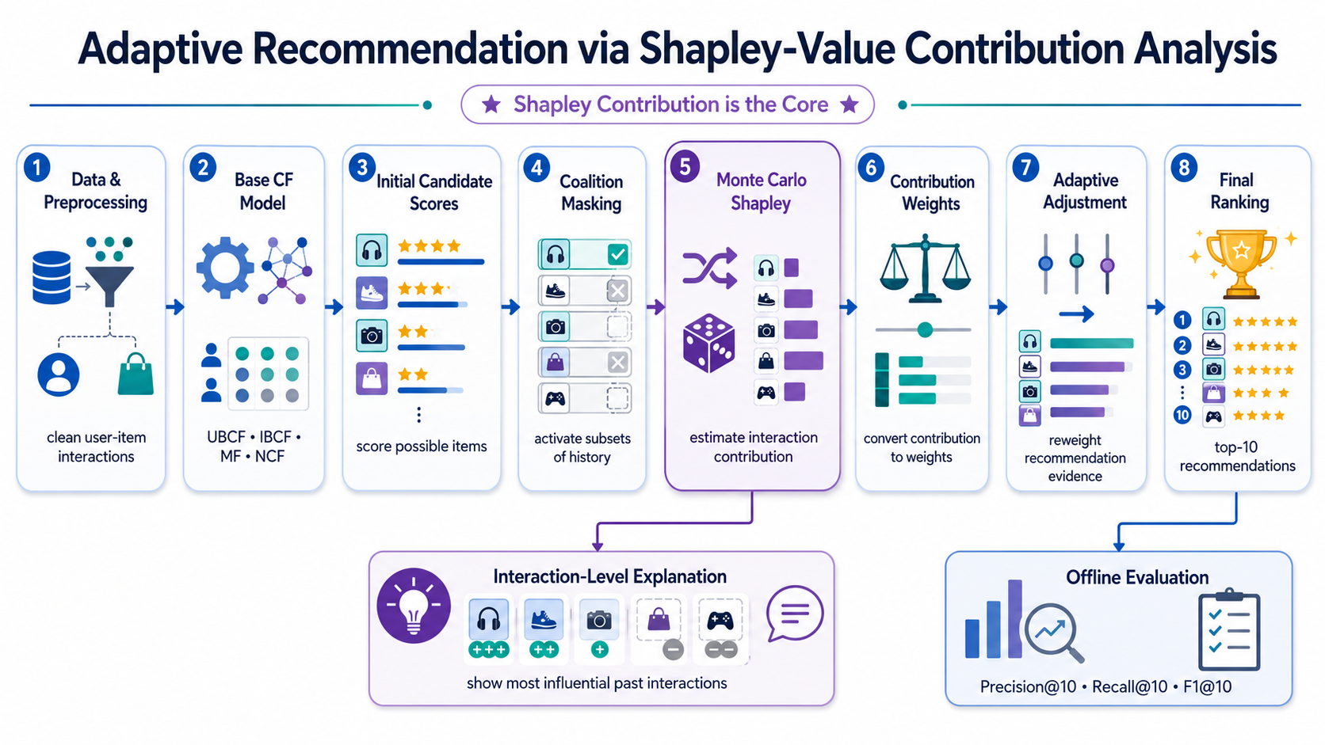
Dynamic Recommender Systems with Real-time Shapley Value-based Contribution Adjustment
Objectives
Methodology
Results
Findings
Architecture Walkthrough
PhD Viva – Redwane NESMAOUI – XAI for Decision-Making in Graph-Based Recommendation Systems
Notes:
At a high level: I model each historical interaction as a player in a cooperative game, using the model's recommendation score as the value function. Monte Carlo sampling estimates each interaction's Shapley contribution, which is then converted into an adaptive weight and fed back into the recommender the same score doubles as an explanation.

Slide 44
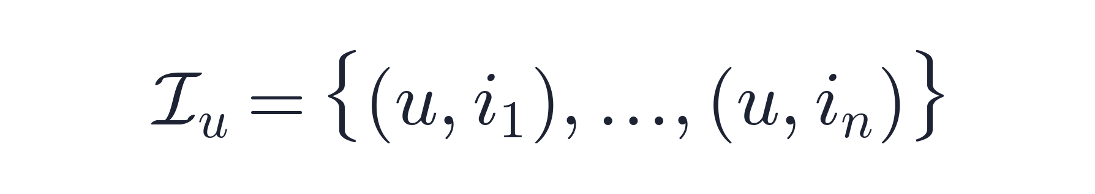




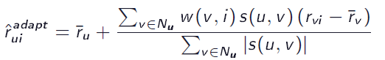
Dynamic Recommender Systems with Real-time Shapley Value-based Contribution Adjustment
Objectives
Methodology
Results
Findings
Architecture Walkthrough
Let
be user u’s historical interactions. For candidate item j and coalition
The Shapley value of interaction e is its expected marginal contribution over all coalitions:
Shapley scores become adaptive interaction weights:
Applied directly inside the scoring rule of the base model, e.g. for user-based CF:
PhD Viva – Redwane NESMAOUI – XAI for Decision-Making in Graph-Based Recommendation Systems
Notes:
At a high level: I model each historical interaction as a player in a cooperative game, using the model's recommendation score as the value function. Monte Carlo sampling estimates each interaction's Shapley contribution, which is then converted into an adaptive weight and fed back into the recommender the same score doubles as an explanation.

Slide 45
Dynamic Recommender Systems with Real-time Shapley Value-based Contribution Adjustment
Objectives
Methodology
Results
Findings
Evaluation protocol
Datasets: MovieLens-1M and Amazon Product Reviews.
Task: sampled-candidate top-10 recommendation.
Candidate set: held-out positives plus 99 sampled unobserved items per user.
Metrics: Precision@10, Recall@10, and F1@10.
Evidence limitation: the main values are point estimates; complete multi-seed variance was not available.
PhD Viva – Redwane NESMAOUI – XAI for Decision-Making in Graph-Based Recommendation Systems
Notes:
I evaluate with sampled-candidate top-10 ranking on MovieLens-1M and Amazon: held-out positives plus 99 sampled negatives per user, measuring Precision, Recall, and F1 at 10. *(Note: point estimates only — full multi-seed variance wasn't available; I flag that as a limitation.)*

Slide 46
Dynamic Recommender Systems with Real-time Shapley Value-based Contribution Adjustment
Objectives
Methodology
Results
Findings
Key results findings - Movielens 1M
ASV (Adaptive Shapley Value) improves every baseline, confirming that contribution-aware weighting is broadly effective.
ASV-MF achieves the best overall F1 score at 0.840, with a 9.4% improvement.
ASV-NCF shows the smallest gain, suggesting limited improvement when the baseline is already strong.
Model | Precision@10 | Recall@10 | F1@10
UBCF | 0.750 | 0.650 | 0.696
ASV-UBCF | 0.820 | 0.709 | 0.760
IBCF | 0.780 | 0.700 | 0.738
ASV-IBCF | 0.851 | 0.763 | 0.805
MF | 0.810 | 0.730 | 0.768
ASV-MF | 0.886 | 0.798 | 0.840
NCF | 0.850 | 0.780 | 0.813
ASV-NCF | 0.873 | 0.796 | 0.832
PhD Viva – Redwane NESMAOUI – XAI for Decision-Making in Graph-Based Recommendation Systems
Notes:
Applying Adaptive Shapley Value weighting — ASV — improves every baseline. ASV-MF gets the best overall F1 at 0.840, a 9.4% improvement. ASV-NCF shows the smallest gain, which makes sense — NCF was already the strongest baseline, so there's less headroom.

Slide 47
Dynamic Recommender Systems with Real-time Shapley Value-based Contribution Adjustment
Objectives
Methodology
Results
Findings
Key results findings – Amazon Products
ASV-IBCF achieves the largest F1 improvement at 12.0%.
ASV-NCF also shows a strong gain, improving F1 by 10.9%.
ASV-MF records the highest F1 score, but its improvement is only 0.95%.
Model | Precision@10 | Recall@10 | F1@10
UBCF | 0.698 | 0.673 | 0.685
ASV-UBCF | 0.768 | 0.740 | 0.753
IBCF | 0.705 | 0.696 | 0.700
ASV-IBCF | 0.790 | 0.779 | 0.784
MF | 0.886 | 0.800 | 0.841
ASV-MF | 0.898 | 0.808 | 0.849
NCF | 0.742 | 0.715 | 0.728
ASV-NCF | 0.841 | 0.776 | 0.807
PhD Viva – Redwane NESMAOUI – XAI for Decision-Making in Graph-Based Recommendation Systems
Notes:
On Amazon, the pattern shifts: ASV-IBCF gets the largest F1 improvement at 12%, ASV-NCF also gains strongly at 10.9%, but ASV-MF — the best performer on MovieLens — only improves 0.95% here. This tells us gains depend on how much headroom the baseline has, and that behavior is dataset-dependent.

Slide 48
Dynamic Recommender Systems with Real-time Shapley Value-based Contribution Adjustment
Objectives
Methodology
Results
Findings
Computational overhead
ASV-IBCF has the highest overhead.
ASV-NCF has the lowest training overhead.
All variants increase latency and memory.
Enhanced Method | Training-Time Overhead | Prediction-Time Change | Memory Change
ASV-UBCF | +60% | 8.7 → 14.2 ms | 145 → 189 MB
ASV-IBCF | +83% | 7.4 → 13.8 ms | 138 → 185 MB
ASV-MF | +39% | 12.1 → 18.9 ms | 267 → 341 MB
ASV-NCF | +30% | 15.4 → 24.7 ms | 412 → 523 MB
PhD Viva – Redwane NESMAOUI – XAI for Decision-Making in Graph-Based Recommendation Systems
Notes:
This benefit isn't free: ASV-IBCF has the highest training overhead at +83%, and all variants increase latency and memory. I report this transparently because it's central to judging practical deployability.

Slide 49
Dynamic Recommender Systems with Real-time Shapley Value-based Contribution Adjustment
Objectives
Methodology
Results
Findings
Answers to the questions and objectives
Each interaction receives a recommendation-specific Shapley contribution.
Across both datasets, all ASV variants improve their baselines, with F1 gains from 0.95% to 12.0%.
The same scores support both reweighting and interaction-level explanation.
Overhead can be substantial: ASV-MF performs best on MovieLens, ASV-NCF on Amazon, while ASV-MF offers weak value on Amazon.
The results show offline contribution-aware adjustment, not long-term streaming adaptation.
PhD Viva – Redwane NESMAOUI – XAI for Decision-Making in Graph-Based Recommendation Systems
Notes:
So: each interaction gets a recommendation-specific Shapley contribution; across both datasets, all ASV variants improve their baseline, F1 gains ranging from under 1% to 12%; the same scores support both reweighting and explanation. But overhead can be substantial, and — critically — what we show here is offline contribution-aware adjustment, not long-term streaming adaptation.

Slide 50
Dynamic Recommender Systems with Real-time Shapley Value-based Contribution Adjustment
Objectives
Methodology
Results
Findings
Key findings
Broadly reusable: Improves neighborhood, latent-factor, and neural models.
Dual purpose: Shapley values support both weighting and explanation.
Uneven gains: Strong baselines may have limited headroom, as with ASV-MF on Amazon.
Efficiency cost: Monte Carlo reduces complexity but increases training, prediction, and memory use.
Limited adaptivity: Supports inference-time or precomputed reweighting, not continuous production learning.
Different integration: UBCF/IBCF adjust scores directly; MF/NCF use offline enhancement.
PhD Viva – Redwane NESMAOUI – XAI for Decision-Making in Graph-Based Recommendation Systems
Notes:
Six findings: the method is broadly reusable across neighborhood, latent-factor, and neural models; it's dual-purpose — weighting and explanation from the same signal; gains are uneven depending on baseline strength; there's a real efficiency cost from Monte Carlo estimation; adaptivity is limited to inference-time or precomputed reweighting, not continuous learning; and the integration mechanism differs by model family.

Slide 51
Dynamic Recommender Systems with Real-time Shapley Value-based Contribution Adjustment
Objectives
Methodology
Results
Findings
Limitations
High computation: Shapley estimation is costly for long histories.
Clean input bias: Implicit positives are less noisy than real production signals.
No drift testing: Controlled preference changes were not evaluated.
No live validation: No A/B test or dedicated user study was conducted.
Limited statistics: Multi-seed variance and paired significance tests are missing.
Limited model scope: Deep graph recommenders were not tested.
Sampled ranking bias: Results may overstate full-catalog performance.
PhD Viva – Redwane NESMAOUI – XAI for Decision-Making in Graph-Based Recommendation Systems
Notes:
Honestly stated: Shapley estimation is expensive for long interaction histories, we tested on relatively clean implicit-positive data rather than noisier production signals, we didn't test controlled preference drift, there's no live A/B validation, limited statistical rigor around variance, and we didn't test deep graph recommenders.

Slide 52
Dynamic Recommender Systems with Real-time Shapley Value-based Contribution Adjustment
Objectives
Methodology
Results
Findings
Takeaways
Current limitation: The current contribution models flat user–item structures in Euclidean space.
Hierarchical domains: Movies map to genres, while products belong to nested categories.
Preference propagation: Item preferences may influence related categories and their ancestors.
Takeaway – Contribution II
We must address Euclidean distortion and flat explanations by modeling user–item–category hierarchies in non-Euclidean space, extending Shapley attribution, generating multi-level explanations, and evaluating their faithfulness and usefulness.
PhD Viva – Redwane NESMAOUI – XAI for Decision-Making in Graph-Based Recommendation Systems
Notes:
The limitation that carries forward: this contribution still models flat user-item structure in Euclidean space. But movies belong to genres, products belong to nested categories these are hierarchical domains, and preferences at one level can propagate to related categories. That's the motivation for Contribution III: modeling these hierarchies in non-Euclidean space, and extending Shapley attribution to multiple levels.

Slide 53
Contribution III
Graph Neural Networks with Shapley-Value Explanations for Hierarchical Recommendation Systems
PhD Viva – Redwane NESMAOUI – XAI for Decision-Making in Graph-Based Recommendation Systems
Notes:
The third and final contribution: graph neural networks with Shapley-value explanations for hierarchical recommendation systems.

Slide 54
Graph Neural Networks with Shapley-Value Explanations for Hierarchical Recommendation Systems
Objectives
Methodology
Results
Findings
Research Gap
Products are organized into categories and subcategories
Movies belong to genres
Preferences can exist at item, category, and higher abstraction levels
Parent–child relations create long-range dependencies.
Research Gap
Hyperbolic models are more expressive for hierarchical data but harder to interpret. Existing Shapley-based explainers are commonly designed around Euclidean scoring and do not automatically preserve consistency with hyperbolic distance.
[29] T. Markchom, H. Liang, and J. Ferryman, "Review of Explainable Graph-Based Recommender Systems," arXiv:2408.00166, 2024.
[30] X. He, "Graph Neural Networks in Recommender Systems," Applied and Computational Engineering, vol. 79, pp. 184–191, 2024.
[31] X. Yang et al., "HgFormer: Hyperbolic Graph Transformer for Collaborative Filtering," Proceedings of the 42nd International Conference on Machine Learning (ICML), 2025.
[32] Y. Zhang et al., "Hyperbolic Graph Representation Learning: Methods, Applications and Challenges—A Survey," Neurocomputing, vol. 652, Art. no. 131044, 2025.
PhD Viva – Redwane NESMAOUI – XAI for Decision-Making in Graph-Based Recommendation Systems
Notes:
Products live in categories and subcategories, movies in genres preferences exist at the item level, the category level, and higher abstraction levels, creating long-range parent-child dependencies. Hyperbolic geometry is more expressive for this kind of hierarchical data, but harder to interpret — existing Shapley explainers are built around Euclidean scoring and don't automatically stay consistent with hyperbolic distance. That's the gap I close here.

Slide 55
Graph Neural Networks with Shapley-Value Explanations for Hierarchical Recommendation Systems
Objectives
Methodology
Results
Findings
Research Questions → Objectives
ID | Research Question | Objective
RQ3.1 | Does hyperbolic learning improve accuracy for hierarchical user–item relations? | Compare the full model with Euclidean, flattened, LightGCN, and Hyperbolic GCN baselines.
RQ3.2 | Can Shapley explanations be added without reducing performance? | Compute hyperbolic Shapley contributions and compare with a non-Shapley variant.
RQ3.3 | Do explanations reflect hierarchy and user preferences? | Test hierarchical relevance, faithfulness, user judgments, and preference alignment.
PhD Viva – Redwane NESMAOUI – XAI for Decision-Making in Graph-Based Recommendation Systems
Notes:
Three questions: does hyperbolic learning improve accuracy for hierarchical relations; can Shapley explanations be added without hurting performance; and do the explanations actually reflect hierarchy and user preferences — tested through faithfulness and user judgment, not just accuracy.

Slide 56
Graph Neural Networks with Shapley-Value Explanations for Hierarchical Recommendation Systems
Objectives
Methodology
Results
Findings
Hyperbolic Space
A curved, negatively-curved space. Distances grow exponentially outward, matching how a tree or hierarchy grows.
First linked to real networks used for representation learning of hierarchies and then extended to graph neural networks.
Movies belong to genres, products to categories, hyperbolic space represents this hierarchy naturally and efficiently. This motivates Contribution III.
[33] D. Krioukov, F. Papadopoulos, M. Kitsak, A. Vahdat, and M. Boguñá, "Hyperbolic Geometry of Complex Networks," Phys. Rev. E, vol. 82, no. 3, p. 036106, 2010.
PhD Viva – Redwane NESMAOUI – XAI for Decision-Making in Graph-Based Recommendation Systems
Notes:
Experiments ran on a ThinkPad X1 Carbon for the first contribution and a MacBook Pro M4 Max for the second and third, I mention this mainly for reproducibility and because it explains some of the runtime figures you'll see later

Slide 57
Graph Neural Networks with Shapley-Value Explanations for Hierarchical Recommendation Systems
Objectives
Methodology
Results
Findings
PhD Viva – Redwane NESMAOUI – XAI for Decision-Making in Graph-Based Recommendation Systems
Notes:
Experiments ran on a ThinkPad X1 Carbon for the first contribution and a MacBook Pro M4 Max for the second and third, I mention this mainly for reproducibility and because it explains some of the runtime figures you'll see later

Slide 58
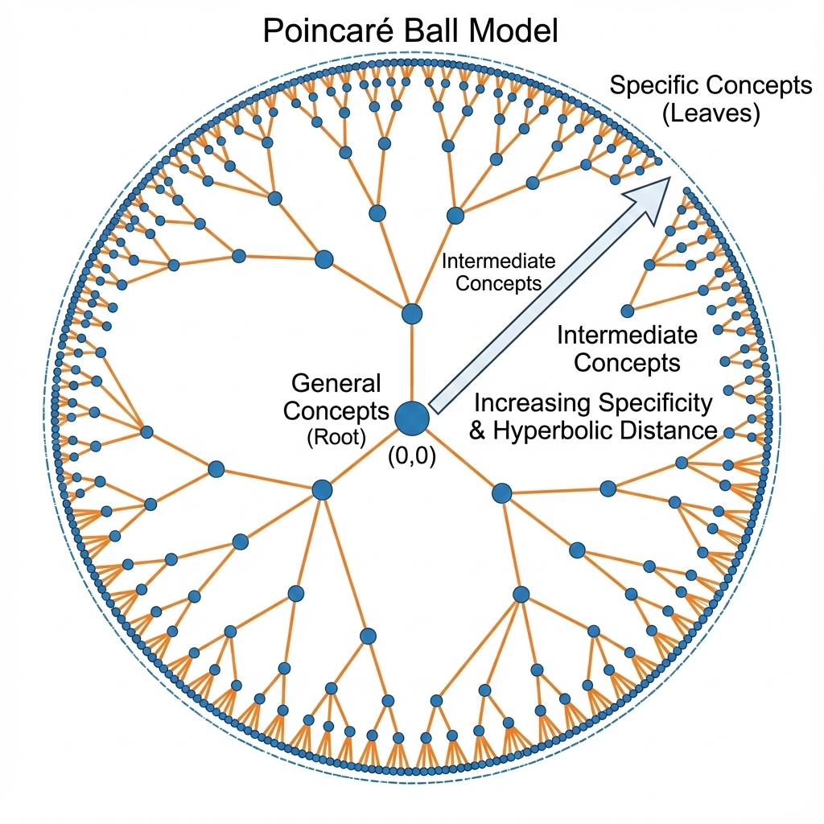
Graph Neural Networks with Shapley-Value Explanations for Hierarchical Recommendation Systems
Objectives
Methodology
Results
Findings
The Poincare Model
A practical model for computing in hyperbolic space. Points sit inside a ball; the edge represents infinity, and the maths stays compatible with gradient-based training.
It is used for word hierarchies like WordNet, hyperbolic GNNs; recent 2024–2025 work applies it directly to hierarchical recommendation.
It is the best-supported hyperbolic model for deep learning, integrates directly into GNN training, and has proven successful in prior hierarchical recommendation work.
[34] M. Nickel and D. Kiela, "Poincaré Embeddings for Learning Hierarchical Representations," in Proc. Adv. Neural Inf. Process. Syst. (NeurIPS), 2017, pp. 6338–6347.
PhD Viva – Redwane NESMAOUI – XAI for Decision-Making in Graph-Based Recommendation Systems
Notes:
Experiments ran on a ThinkPad X1 Carbon for the first contribution and a MacBook Pro M4 Max for the second and third, I mention this mainly for reproducibility and because it explains some of the runtime figures you'll see later

Slide 59
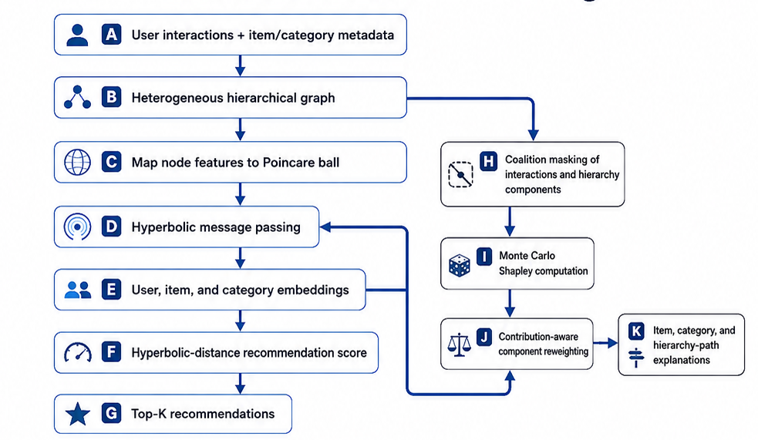
Graph Neural Networks with Shapley-Value Explanations for Hierarchical Recommendation Systems
Objectives
Methodology
Results
Findings
Architecture Walkthrough
PhD Viva – Redwane NESMAOUI – XAI for Decision-Making in Graph-Based Recommendation Systems
Notes:
The model embeds users and items in hyperbolic space to naturally capture hierarchy, then computes Shapley contributions adapted to hyperbolic distance rather than Euclidean scoring, producing both a ranking and a multi-level, hierarchy-aware explanation.

Slide 60
Graph Neural Networks with Shapley-Value Explanations for Hierarchical Recommendation Systems
Objectives
Methodology
Results
Findings
Evaluation protocol
Datasets: MovieLens-1M and Amazon Product Reviews.
Task: sampled-candidate top-k ranking.
Candidate set: held-out positives plus 99 sampled unobserved items per user.
Metrics: Precision@10, Recall@10, and F1@10.
Evidence limitation: Ablation, Runtime, Perturbation faithfulness, and user study.
PhD Viva – Redwane NESMAOUI – XAI for Decision-Making in Graph-Based Recommendation Systems
Notes:
Same sampled-candidate top-K setup as before, on MovieLens-1M and Amazon, but this time I add ablation studies, runtime analysis, perturbation-based faithfulness tests, and a user study a more complete evidence package than Contribution II.

Slide 61
Graph Neural Networks with Shapley-Value Explanations for Hierarchical Recommendation Systems
Objectives
Methodology
Results
Findings
Key results findings - Movielens 1M
Hyperbolic GNN + Shapley achieves the best results across all metrics.
Hyperbolic GCN outperforms LightGCN, showing the value of hierarchical geometry.
Recall@10 shows the largest improvement, indicating better retrieval of relevant items.
Method | Precision@10 | Recall@10 | F1@10
LightGCN | 0.763 | 0.703 | 0.732
Hyperbolic GCN | 0.795 | 0.742 | 0.768
LightGCN + GNNShap | 0.774 | 0.715 | 0.743
LightGCN + MAGE | 0.783 | 0.731 | 0.756
HGNN-SV | 0.822 | 0.785 | 0.803
PhD Viva – Redwane NESMAOUI – XAI for Decision-Making in Graph-Based Recommendation Systems
Notes:
HGNN-SV my full model achieves the best results across all metrics. Hyperbolic GCN alone already beats LightGCN, showing the geometry itself matters, and adding Shapley on top gives a further boost, with the largest gains in Recall@10.

Slide 62
Graph Neural Networks with Shapley-Value Explanations for Hierarchical Recommendation Systems
Objectives
Methodology
Results
Findings
Ablation study - Movielens 1M
Variant | Precision@10 | Recall@10 | F1@10 | F1 drop
Full model | 0.822 | 0.785 | 0.803 | —
Without Shapley | 0.816 | 0.774 | 0.794 | -0.009
Without hyperbolic geometry | 0.792 | 0.749 | 0.770 | -0.033
Without hierarchy | 0.758 | 0.723 | 0.740 | -0.063
PhD Viva – Redwane NESMAOUI – XAI for Decision-Making in Graph-Based Recommendation Systems
Notes:
Removing hierarchy costs the most a 0.063 F1 drop more than removing hyperbolic geometry (-0.033) or Shapley (-0.009). This confirms hierarchical modeling is the main driver, with geometry and explainability contributing incrementally on top.

Slide 63
Graph Neural Networks with Shapley-Value Explanations for Hierarchical Recommendation Systems
Objectives
Methodology
Results
Findings
Ablation study – Amazon Products
Variant | Precision@10 | Recall@10 | F1@10 | F1 drop
Full model | 0.785 | 0.730 | 0.756 | —
Without Shapley | 0.777 | 0.716 | 0.745 | -0.011
Without hyperbolic geometry | 0.753 | 0.692 | 0.721 | -0.035
Without hierarchy | 0.719 | 0.663 | 0.690 | -0.066
PhD Viva – Redwane NESMAOUI – XAI for Decision-Making in Graph-Based Recommendation Systems
Notes:
The same pattern holds on Amazon: removing hierarchy hurts most, at -0.066 F1, followed by geometry and then Shapley. Consistent across both domains.

Slide 64
Graph Neural Networks with Shapley-Value Explanations for Hierarchical Recommendation Systems
Objectives
Methodology
Results
Findings
Computational overhead
Training is 33–38% slower than Hyperbolic GCN.
Inference is 41–50% slower across the two datasets.
The overhead is manageable experimentally, but production readiness is not yet established.
Method | MovieLens train / infer (s) | Amazon train / infer (s)
LightGCN | 8.5 / 1.2 | 22.3 / 3.1
Hyperbolic GCN | 11.7 / 1.6 | 27.9 / 4.4
LightGCN + GNNShap | 14.2 / 2.3 | 35.1 / 5.8
Full model | 15.6 / 2.4 | 38.5 / 6.2
PhD Viva – Redwane NESMAOUI – XAI for Decision-Making in Graph-Based Recommendation Systems
Notes:
Training is 33–38% slower than plain Hyperbolic GCN, inference 41–50% slower. Manageable experimentally, but I'm upfront that production readiness isn't established yet

Slide 65
Graph Neural Networks with Shapley-Value Explanations for Hierarchical Recommendation Systems
Objectives
Methodology
Results
Findings
Answers to the questions and objectives
Supported within protocol: GNN-CF achieved the highest precision and recall.
Partially supported: Recall gains suggest benefits from multi-hop collaborative signals, but propagation depth was not isolated.
Supported: A simple LightGCN-style model performed best without complex transformations.
Clearly established: The model uses uniform edge weights, cannot reweight interactions, and lacks local explanations.
PhD Viva – Redwane NESMAOUI – XAI for Decision-Making in Graph-Based Recommendation Systems
Notes:
Within the evaluation protocol: the full model achieves the highest precision and recall supported. Recall gains suggest multi-hop benefits, though propagation depth wasn't isolated partially supported. A simple LightGCN-style backbone performs best without added complexity supported. And clearly established: without this contribution, edge weights stay uniform, with no local explanations.

Slide 66
Graph Neural Networks with Shapley-Value Explanations for Hierarchical Recommendation Systems
Objectives
Methodology
Results
Findings
Key findings
Graph structure improves edge-prediction beyond matrix methods.
Higher-order neighborhoods mainly improve recall.
Simple LightGCN-style architecture is sufficient as a strong baseline.
Predictive accuracy does not address static weighting or explainability.
Results should be framed as link prediction, not top-N ranking.
PhD Viva – Redwane NESMAOUI – XAI for Decision-Making in Graph-Based Recommendation Systems
Notes:
Graph structure improves edge prediction beyond matrix methods, higher-order neighborhoods mainly help recall, a simple architecture is a sufficient baseline but predictive accuracy alone doesn't solve static weighting or explainability, and results should be framed as link prediction, not top-N ranking.

Slide 67
Graph Neural Networks with Shapley-Value Explanations for Hierarchical Recommendation Systems
Objectives
Methodology
Results
Findings
Limitations
The model closely resembles LightGCN and is not a fundamentally new GNN architecture.
Evaluation is limited to MovieLens-1M and link prediction.
No ablation isolates propagation depth or layer aggregation.
All interactions are weighted uniformly.
The model provides no local explanations.
Preference adaptation is not validated.
Claims should follow the link-prediction experiment and not imply top-N ranking.
PhD Viva – Redwane NESMAOUI – XAI for Decision-Making in Graph-Based Recommendation Systems
Notes:
As with the earlier contributions: this model resembles established architectures rather than being fundamentally novel, evaluation is limited to MovieLens-1M under link prediction, no ablation isolates propagation depth, interactions are uniformly weighted, there are no local explanations here, and preference adaptation isn't validated claims should follow the link-prediction framing, not imply top-N ranking.

Slide 68
Graph Neural Networks with Shapley-Value Explanations for Hierarchical Recommendation Systems
Objectives
Methodology
Results
Findings
Takeaways
Graph propagation is effective, but all historical interactions are treated uniformly.
Shapley values identify which interactions drive each recommendation.
Contribution scores enable adaptive weighting and understandable explanations.
Takeaway – Contribution III
The contribution moves beyond static graph propagation by measuring interaction importance. It uses these contributions both to improve recommendation generation and to explain the result.
PhD Viva – Redwane NESMAOUI – XAI for Decision-Making in Graph-Based Recommendation Systems
Notes:
Graph propagation is effective, but treats history uniformly. Shapley values identify which interactions actually drive a recommendation. Together, contribution scores enable both adaptive weighting and understandable explanations which is really the thesis-level synthesis: moving beyond static propagation by measuring and using interaction importance.

Slide 69
Conclusion & Perspectives
PhD Viva – Redwane NESMAOUI – XAI for Decision-Making in Graph-Based Recommendation Systems
Notes:
Let me now bring everything together.

Slide 70
Conclusion & Perspectives
Synthesis
Limitations
Perspectives
Conclusion
Contribution | Main Idea | Main Achievement | Key Finding
C1 | Explainable graph-based recommendation using Shapley values | Introduced faithful explanations for GNN-based recommender systems by quantifying the contribution of historical user–item interactions. | Explainability improves transparency while preserving recommendation performance.
C2 | Adaptive recommendation through contribution-aware inference | Leveraged Shapley contributions to dynamically reweight historical interactions during inference. | Adaptive weighting improves recommendation robustness and personalization.
C3 | Hyperbolic graph neural networks for recommendation | Modeled hierarchical user–item relationships in hyperbolic space to better capture latent structures. | Hyperbolic representations outperform Euclidean embeddings for hierarchical recommendation.
Takeaway – Thesis
Overall, this thesis progressively integrates explainability, adaptivity, and hyperbolic representation learning into a unified framework for accurate, transparent, and robust graph-based recommender systems.
PhD Viva – Redwane NESMAOUI – XAI for Decision-Making in Graph-Based Recommendation Systems
Notes:
Three contributions, one thread: C1 introduces faithful, GNN-based explanations via interaction contribution; C2 uses those contributions to adaptively reweight recommendations at inference time; C3 extends everything into hyperbolic space to properly capture hierarchy. The common thesis-level takeaway: explainability, adaptivity, and hyperbolic representation learning are progressively integrated into one unified framework.

Slide 71
Conclusion & Perspectives
Synthesis
Limitations
Perspectives
Conclusion
Published Research Papers
No. | Title | Journal | Status
I | Dynamic Recommender Systems with Real-time Shapley Value-based Contribution Adjustment | International Journal of Intelligent Engineering and Systems | Published, 2025
II | Graph Neural Networks with Shapley-Value Explanations for Hierarchical Recommendation Systems | International Journal of Advanced Computer Science and Applications | Published, 2025
III | Shapley Values for Explaining Adaptive Recommendations in Temporal Hyperbolic Graph Neural Networks | Discover Artificial Intelligence | Under review
IV | Toward Temporal Stability in Explainable AI: A Framework for Measuring Explanation Drift | Results in Engineering | Under review
PhD Viva – Redwane NESMAOUI – XAI for Decision-Making in Graph-Based Recommendation Systems
Notes:
This work resulted in four journal-track papers: two published in 2025, one accepted in 2026, and one currently under review I'll let you read the titles rather than list them all.

Slide 72
Conclusion & Perspectives
Synthesis
Limitations
Perspectives
Conclusion
Published Research Papers
No. | Title | Conference | Status
V | A Collaborative Filtering Movies Recommendation System based on Graph Neural Network | ANT / EDI40 | Published, 2023
VI | A Hybrid Machine Learning Method for Movies Recommendation | BDIoT | Published, 2022
PhD Viva – Redwane NESMAOUI – XAI for Decision-Making in Graph-Based Recommendation Systems
Notes:
Plus two earlier conference papers from 2022 and 2023, which correspond to preliminary work leading into Contribution I.

Slide 73
Conclusion & Perspectives
Synthesis
Limitations
Perspectives
Conclusion
Limited domain evaluation: Experiments were conducted on benchmark datasets (MovieLens and Amazon) validation on additional real-world domains remains necessary.
Scalability of Shapley-based explanations: Although optimized, computing Shapley values remains computationally expensive for very large-scale recommender systems.
Static graph assumption: The proposed models operate on static interaction graphs and do not explicitly model continuously evolving user–item relationships.
Limited multimodal information: The framework primarily exploits user–item interaction data, without integrating textual, visual, or knowledge graph information.
Hyperbolic architecture scope: The hyperbolic approach was evaluated on a specific HGNN architecture; its generalization to other graph neural network models remains to be investigated.
Offline evaluation: Performance was assessed through offline experiments and user studies, without validation in an online production environment (e.g., A/B testing).
PhD Viva – Redwane NESMAOUI – XAI for Decision-Making in Graph-Based Recommendation Systems
Notes:
At the thesis level: evaluation stayed within MovieLens and Amazon, broader domain validation is needed; Shapley computation remains expensive at scale; the graphs are static, not continuously evolving; I don't integrate multimodal signals like text or images; the hyperbolic architecture was tested on one specific HGNN design; and everything was evaluated offline, without live A/B testing.

Slide 74
Conclusion & Perspectives
Synthesis
Limitations
Perspectives
Conclusion
Dynamic Graph Recommender Systems: Extend the proposed framework to temporal and continuously evolving user–item interaction graphs.
Scalable Explainable Recommendation: Develop efficient approximations of Shapley values to support real-time explanations in large-scale recommender systems.
Multimodal Recommendation: Integrate textual, visual, and knowledge graph information to improve both recommendation accuracy and explanation quality.
Advanced Hyperbolic Graph Learning: Investigate more expressive hyperbolic architectures (e.g., Hyperbolic Graph Transformers) and mixed-curvature embedding spaces for complex hierarchical data.
Online and Real-World Deployment: Validate the proposed methods through online A/B testing and deployment in industrial recommender systems to assess long-term user satisfaction, trust, and business impact.
PhD Viva – Redwane NESMAOUI – XAI for Decision-Making in Graph-Based Recommendation Systems
Notes:
Five directions forward: extending to dynamic, continuously evolving graphs; developing scalable Shapley approximations for real-time use; integrating multimodal information; exploring more expressive hyperbolic architectures like hyperbolic graph transformers and mixed-curvature spaces; and validating everything through real online deployment and A/B testing.

Slide 75
Conclusion & Perspectives
Synthesis
Limitations
Perspectives
Conclusion
Thesis Answer
This thesis demonstrates that explainability should not be considered only as a post-hoc interpretation tool, but as a fundamental component for building accurate, adaptive, and trustworthy graph-based recommender systems.
Key Outcomes
Unified framework combining GNNs, Shapley values, adaptive inference, and hyperbolic geometry.
Interpretable recommendations based on interaction-level contribution analysis.
Adaptive personalization through contribution-aware reweighting.
Improved hierarchical modeling with hyperbolic graph neural networks.
Validated performance on MovieLens and Amazon datasets.
PhD Viva – Redwane NESMAOUI – XAI for Decision-Making in Graph-Based Recommendation Systems
Notes:
To close: this thesis shows that explainability shouldn't be treated only as a post-hoc add-on, but as a fundamental design component for building accurate, adaptive, and trustworthy graph-based recommender systems. Concretely, that means a unified framework combining GNNs, Shapley values, adaptive inference, and hyperbolic geometry validated on two real-world datasets.

Slide 76
Questions & Discussion
Thank you for your attention.
I welcome your questions and comments.
PhD Viva – Redwane NESMAOUI – XAI for Decision-Making in Graph-Based Recommendation Systems
Notes:
Thank you very much for your attention. I'm now happy to take your questions.

Slide 77
Doctoral Studies Center in Information and Engineering Sciences and Technologies (ST2I)
Explainable Artificial Intelligence (XAI) for Decision-Making
in Graph-Based Recommendation Systems
PhD Viva Presented by: Redwane NESMAOUI
Jury members:
President | Pr. Abdellatif EL AFIA | PES | ENSIAS, Mohammed V University, Rabat
Supervisor | Pr. Mohamed LAZAAR | PES | ENSIAS, Mohammed V University, Rabat
Reviewer | Pr. M’hamed AIT KBIR | PES | FST, Abdelmalek Essaâdi University, Tangier
Reviewer | Pr. Oussama MAHBOUB | PES | ENSA, Abdelmalek Essaâdi University, Tetouan
Reviewer | Pr. Noureddine KERZAZI | MCH | ENSIAS, Mohammed V University, Rabat
Examiner | Pr. Hicham OMARA | MCH | FP Taza, Sidi Mohamed Ben Abdellah University, Fez
Examiner | Pr. Fatima OUZAYD | PES | ENSIAS, Mohammed V University, Rabat
Examiner | Pr. Yasser EL MADANI EL ALAMI | MCH | ENSIAS, Mohammed V University, Rabat
Guest | Pr. Yassine AFOUDI | MC | Faculty of Sciences, Cadi Ayyad University, Marrakech

Slide 78
Experiment Setup
Datasets
Metrics
Hardware
General Specifications
Specification | MovieLens 1M | MovieLens 100K | Amazon Products
Domain | Movie recommendation | Movie recommendation | E-commerce product recommendation
Source | GroupLens Research | GroupLens Research | McAuley Lab, UC San Diego
Release year | 1998 | 2003 | 2018
Time coverage | Seven-month period ending in 1998 | Ratings collected from MovieLens users in 2000 | May 1996–October 2018
Typical use | Collaborative filtering and benchmarking | Collaborative filtering and rating prediction | Product recommendation, review analysis, and sequential recommendation
[13] GroupLens Research, “MovieLens 100K Dataset,” University of Minnesota. [Online]. Available: https://grouplens.org/datasets/movielens/100k/
PhD Viva – Redwane NESMAOUI – XAI for Decision-Making in Graph-Based Recommendation Systems
Notes:
I use three datasets: MovieLens 1M, MovieLens 100K, and Amazon Product Reviews covering both movie recommendation and e-commerce, which lets me test generalization across domains.

Slide 79
Experiment Setup
Datasets
Metrics
Hardware
Dataset Size and Interaction Statistics
Specification | MovieLens 100K | MovieLens 1M | Amazon Products
Number of users | 943 | 6,040 | ≈15.5 million
Number of items | 1,682 movies | 3,952 movie | ≈9.4 million products
Number of interactions | 100,000 ratings | 1,000,209 ratings | ≈233.1 million reviews
Rating scale | 1–5 stars | 1–5 stars | 1–5 stars
Minimum interactions per user | 20 ratings | 20 ratings | No fixed minimum in the complete dataset
Approximate sparsity | 93.7% | 95.8% | Extremely sparse; varies by category and preprocessing
[14] GroupLens Research, “MovieLens 1M Dataset,” University of Minnesota. [Online]. Available: https://grouplens.org/datasets/movielens/1m/
PhD Viva – Redwane NESMAOUI – XAI for Decision-Making in Graph-Based Recommendation Systems
Notes:
The scale differs enormously, from about 100,000 ratings in MovieLens 100K to over 15,5 million reviews in Amazon — and so does sparsity, from roughly 94% to extremely sparse in Amazon. This range is deliberate: it stress-tests the models under very different data conditions.

Slide 80
Experiment Setup
Datasets
Metrics
Hardware
Dataset Size and Interaction Statistics
Specification | MovieLens 1M | MovieLens 100K | Amazon Products
Feedback type | Explicit ratings | Explicit ratings | Explicit ratings and textual reviews
User information | Gender, age group, occupation, ZIP code | Age, gender, occupation, ZIP code | Reviewer identifier; limited demographic information
Item information | Movie title and genres | Movie title, release date, genres, IMDb URL | Product title, category, brand, price, description, and images where available
Review information | Rating and timestamp | Rating and timestamp | Rating, review text, summary, helpfulness votes, and timestamp
Timestamp available | Yes | Yes | Yes
[15] J. McAuley Lab, “Amazon Review Data (2018),” University of California San Diego. [Online]. Available: https://cseweb.ucsd.edu/~jmcauley/datasets/amazon_v2/
PhD Viva – Redwane NESMAOUI – XAI for Decision-Making in Graph-Based Recommendation Systems
Notes:
All datasets provide explicit ratings and timestamps; Amazon additionally provides textual reviews, which I don't exploit directly in this thesis but flag as future work.

